Slide 1



Document
Scanner
Using ROI, opencv, tkinter

Slide 2
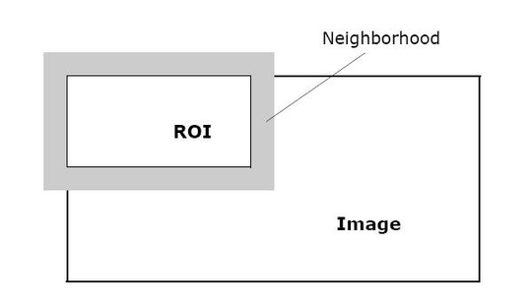


Concepts and Libraries
ROI
(Region Of Interest)
OpenCV
Tkinter

Slide 3
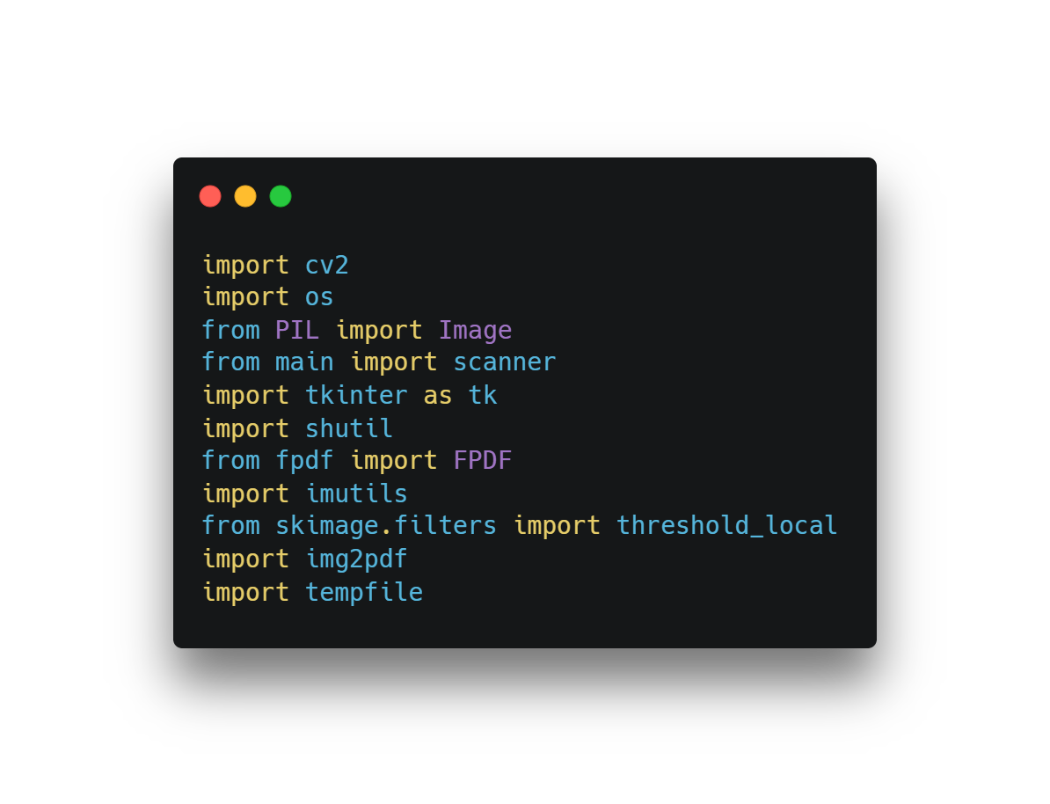
Imported
Libraries

Slide 4
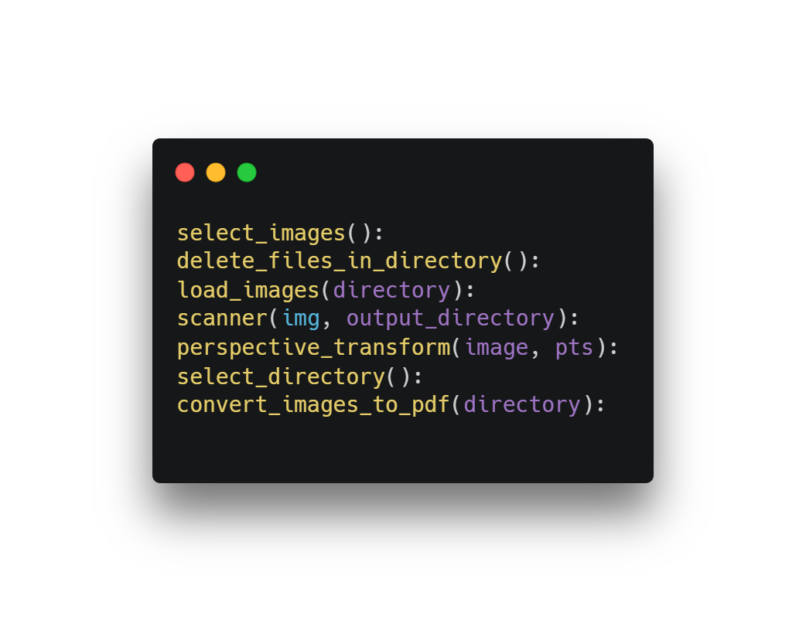
Functions Created

Slide 5
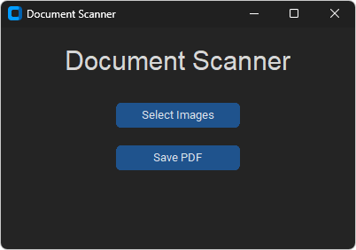
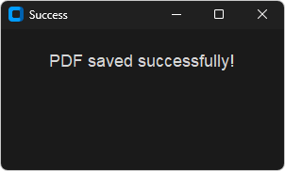
Output

Slide 6

THANK YOU !

